Slide 1
In order to plot radial pair distribution function using VMD, do the following:
Open VMD and load your trajectory
In the VMD Main window, go to Extensions → Analysis → Radial Pair Distribution Function g(r)
Enter the different i and j pair that you want to compute g(r) between in Selection 1 and Selection 2 respectively
A graph should pop up. You can save the coordinates using the ‘File’ tab in the top left corner of the graph, and plot it in excel if you want

Slide 2
Let’s look at the structure of water and of a single protein in a box. Go to /gscratch/stf/sarah/molsim_hw8_files/ and load traj_comp.xtc using confout.gro on VMD.
Take a snapshot of the protein without any water molecules. You can render water transparent, if you’re feeling fancy!
You can tell if the protein is structured by rendering it using “New Ribbons” Drawing Method (in the Graphical Representations GUI). Does this protein have a secondary structure? If yes, what is it?
Using VMD plot g(r) between:
LYS – LEU
SOL – SOL
Can you tell what the first g_{SOL-SOL}(r) peak corresponds to?

Slide 3
BONUS QUESTION (Tau corresponds to a time unit, and Sigma is a unit of length)
The mean squared displacement of a system consisting of 10,000 particles simulated for approximately 920,000 Tau was analyzed, and is as shown in graph (i). Due to noise at long times ( > 100,000 Tau as shown in the inset), it was decided that the data must be block averaged.
Which of the two graphs shown below is the result of block averaging graph (i), and why? (15 pts)
Can you make an approximate estimate of what the size of each block is (in units of Tau), and how many blocks of data there were (assuming that the blocks were not overlapping)? (5 pts)

Slide 4
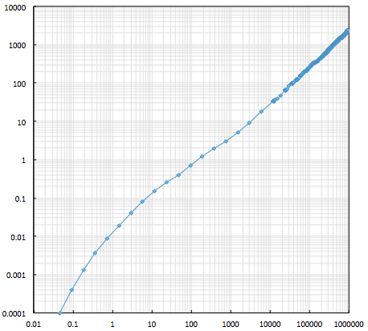
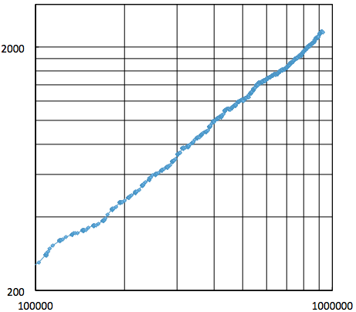
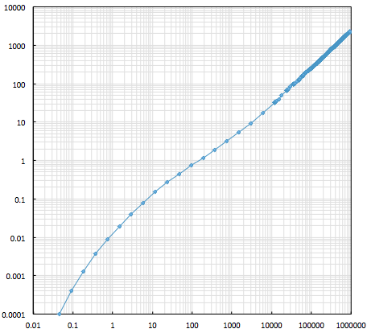
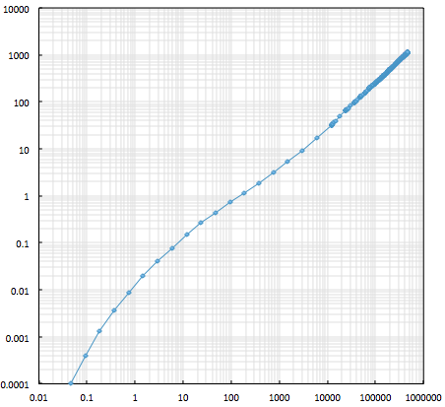
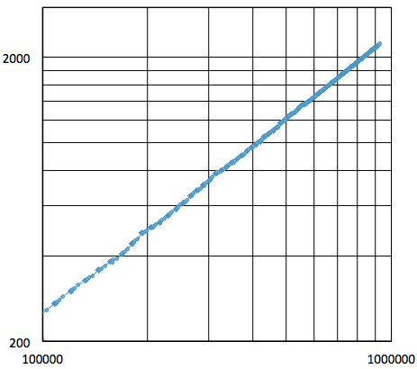
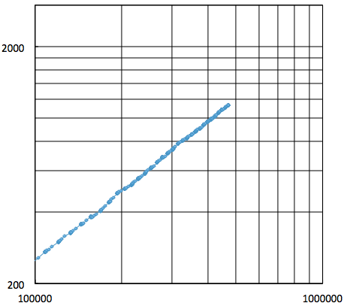
i)
MSD (σ²)
Time (Tau)
ii)
iii)
MSD (σ²)
MSD (σ²)
Time (Tau)
Time (Tau)

